Slide 1

Siesta Sense
Katelyn Canedo, Aveisha Maharaj, Kayla Mastin, Alexis Haley, & Marko Vukasinovic
01/17 Presentation

Slide 2

Motivation & Overview
Covid-19 has caused an increase in patient cases per nurse
Increases risk of death per patient by 31%
Allow healthcare providers the ability to continuously monitor their patients
Designed a 'connected mattress'
Can be alerted when patients vitals are changing too rapidly or fall below a certain threshold
Benefit understaffed hospitals
Comfort for patients
Time logs cut in half (CNA, blood sugar, blood pressure)
Notes:
Kayla

Slide 3

What has been Accomplished:
Hardware
Built Heart Rate sensor
Waiting on Pulse Ox and Temperature completion
Built Arduino breadboard with BLE module
Software
App Layout
Present Live Data for Heart Rate on Home Screen
Compared Apple Watch Data with the Data that was displayed by Heart Rate
Separate pages for each Sensor to display data
Notes:
Aveisha

Slide 4
Progress Evaluation
Module/feature | Completion % | To do
Build, Implement, and Test Heart Rate Sensor | 100%
Build, Implement, and Test Pulse Ox Sensor | 95% | Create a demo video, fully test with new hardware
Build, Implement, and Test Temperature Sensor | 90% | Wait for hardware and test
Notes:
kayla

Slide 5
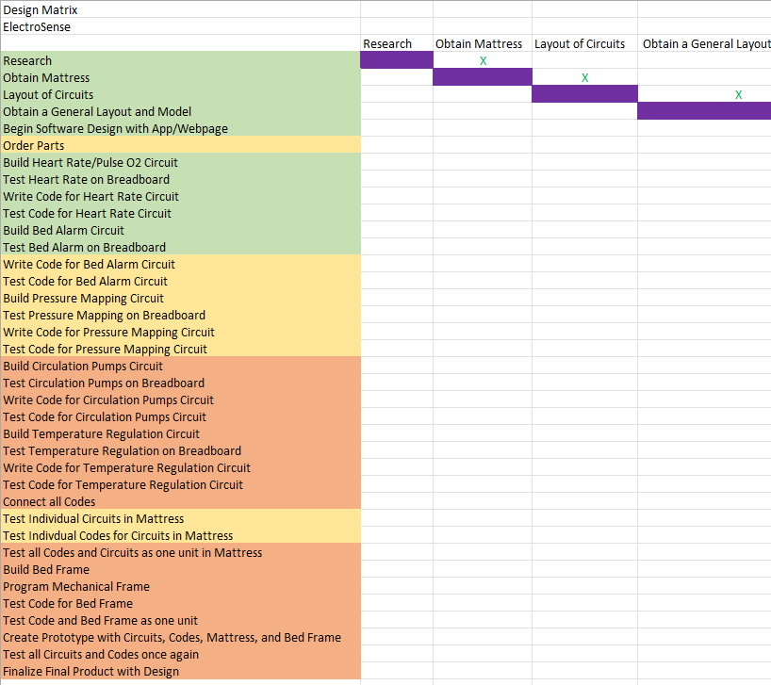
Design Specifications
Designed for a 300 lb weight limit
Designed to assist bedbound ICU patients and hospital staff
Provide comfort to patients and provide constant vitals and notifications of critical vitals
Stress testing
Jumping on the mattress
Notes:
kayla

Slide 6
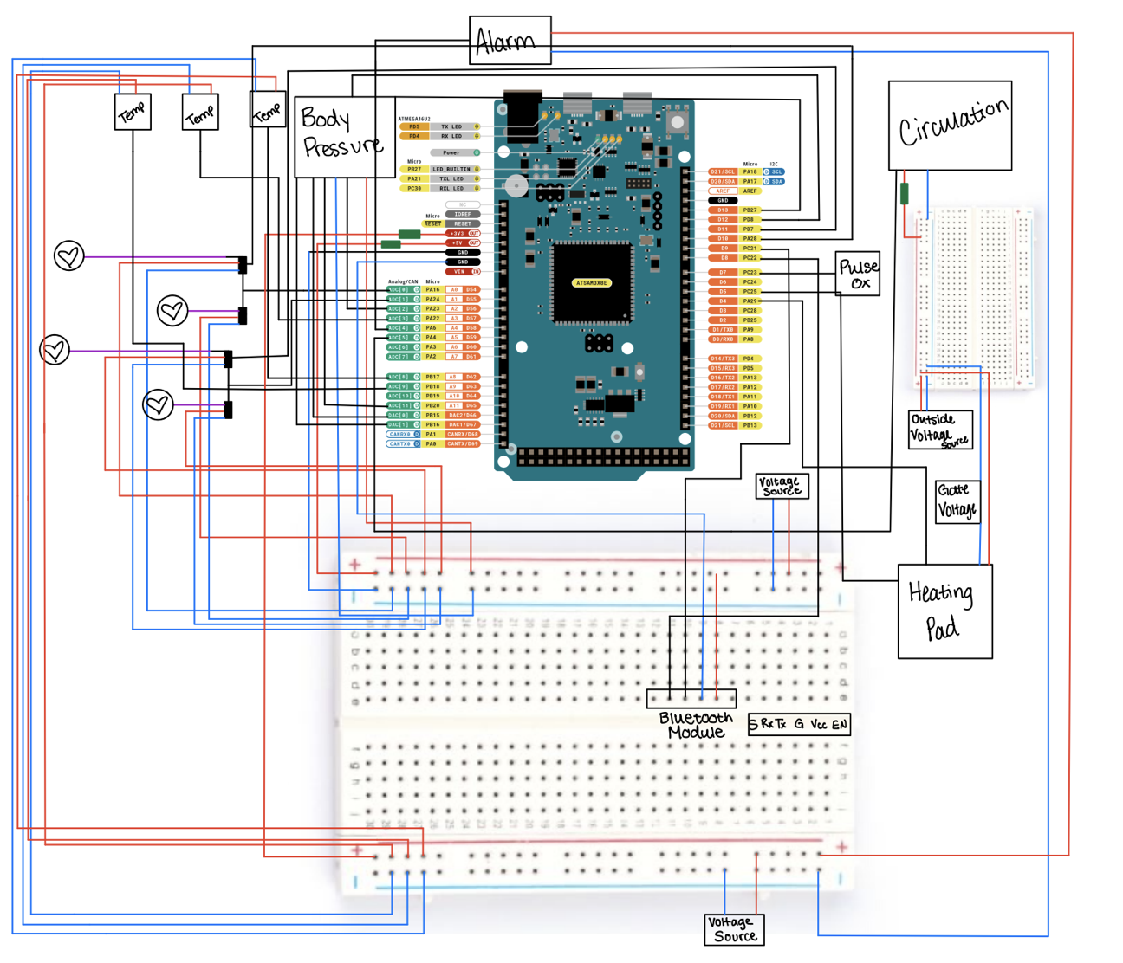
Updated Circuit Diagram
Using analog to digital converters to utilize digital pins for data input
Notes:
kaitie

Slide 7
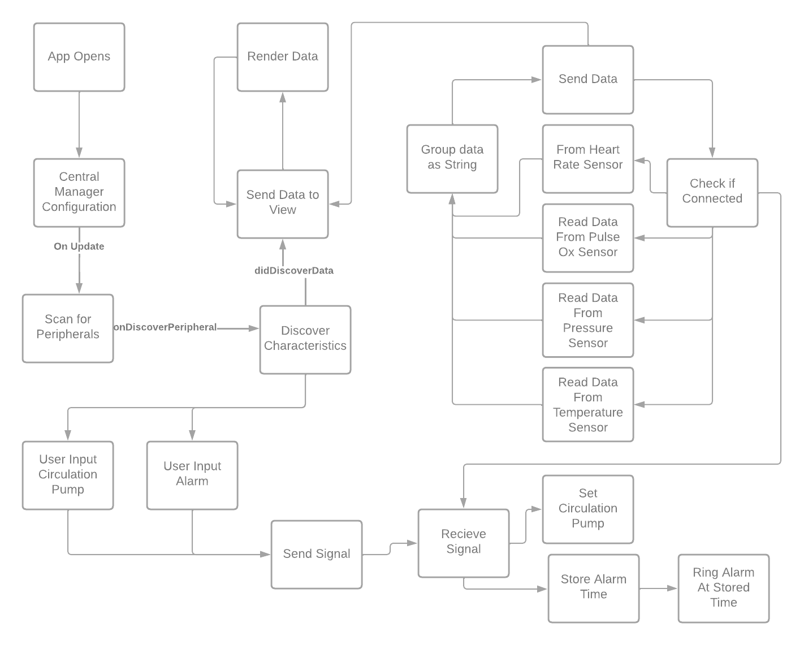
Notes:
kaitie

Slide 8
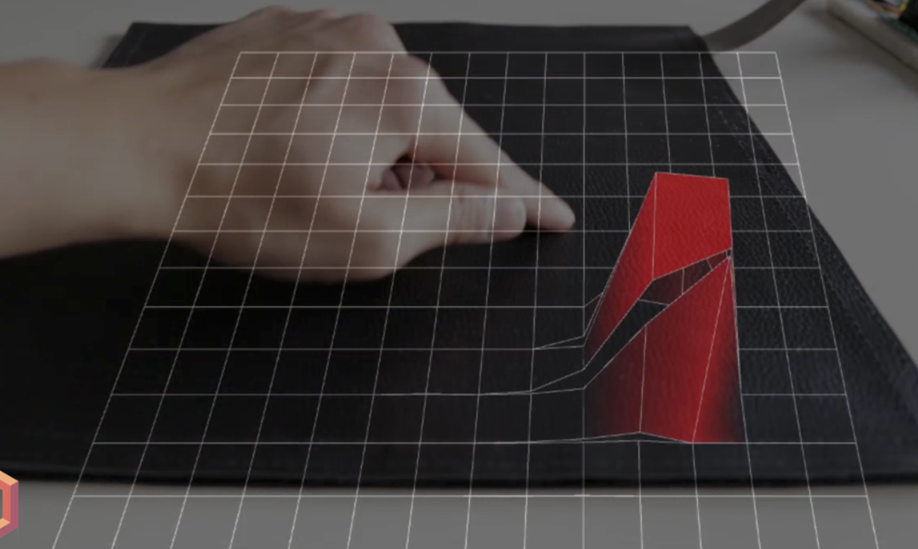
Body Pressure Mapping
Notes:
katie

Slide 9
Game Plan for Software
Milestone 4 (Feb 13): itemized tasks:
Implement, test, and demo Pressure Sensor
Improve Graphical User Interface
Send basic signal from Phone to Arduino
Milestone 5 (Mar 20): itemized tasks:
Implement, test, and demo Alarm
Implement Circulation Pump
Milestone 6 (Apr 17): itemized tasks:
Test, and demo Circulation Pump
Test/demo of the entire system
Conduct evaluation and analyze results
Create user/developer manual
Create demo video
Notes:
alexis

Slide 10
Continued
Connections with all Sensors:
Pulse Ox
Pressure Mapping
Temperature (Heating Pad)
Circulation
Bed Alarm
Connections established through:
Bluetooth
Arduino
App (XCode)
Notes:
alexis

Slide 11
Task Matrix Milestone 4
Task | Marko
Implement, test, and demo which features/modules Pressure Sensor | 100%
Improve Graphical User Interface | 100%
Send basic signal from Phone to Arduino | 100%
Notes:
alexis

Slide 12
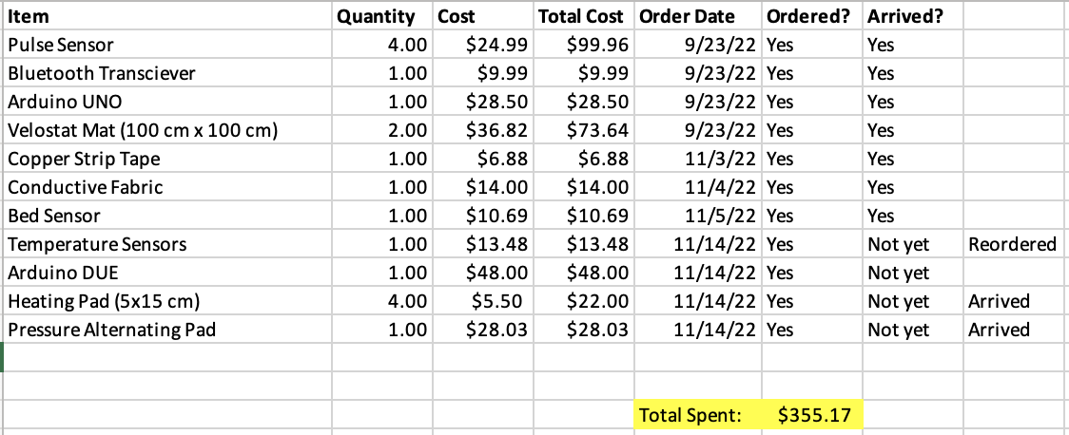

Budget
Notes:
Alexis

Slide 13
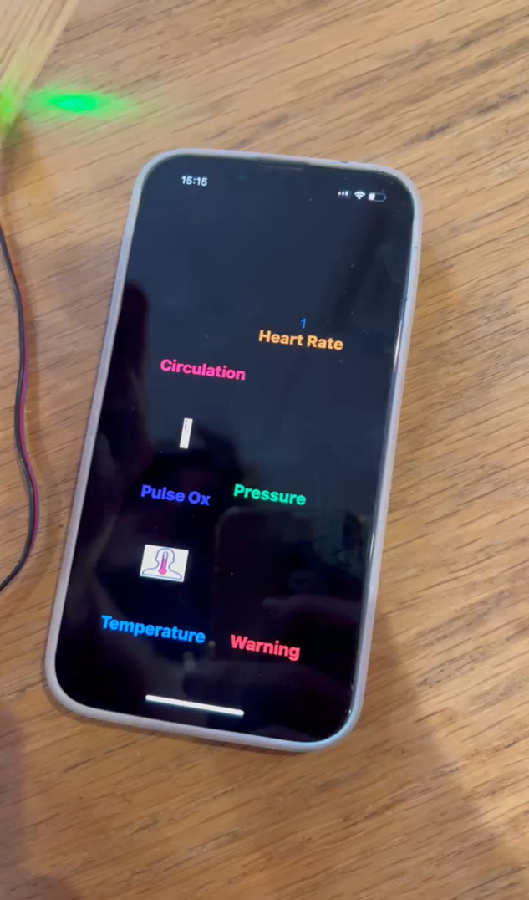
We will have to fix Home Screen (Design Aspect)
App can be displayed on the latest models of iPhones and iPads
Compared sensor readings with Apple Watch

